Slide 1
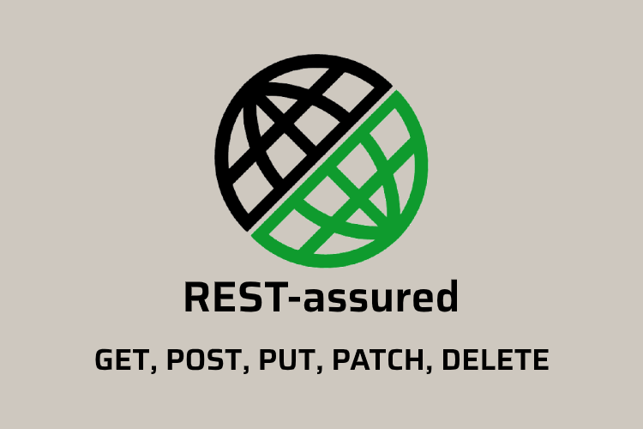
Rest Assured - Create User API Call
RESTful Webservices Client
Spring Boot Application
Create User Request
User CRUD RESTful
Webservices
Create User Response

Slide 2
Rest Assured - User Login API Call
RESTful Webservices Client
Spring Boot Application
User login Request
User CRUD RESTful
Webservices
User login Response

Slide 3
Rest Assured - Get User Details API Call
RESTful Webservices Client
Spring Boot Application
Get User Request
User CRUD RESTful
Webservices
Get User Response

Slide 4
Rest Assured - Update User Details API Call
RESTful Webservices Client
Spring Boot Application
Update User Request
User CRUD RESTful
Webservices
Update User Response

Slide 5
Rest Assured - Delete User Details API Call
RESTful Webservices Client
Spring Boot Application
Delete User Request
User CRUD RESTful
Webservices
Delete User Response

